Slide 1
Coursera Capstone Project Report
Project to Predict
Accident Collision Severity

Slide 2
Introduction

Slide 3
Introduction …I
Background
Accidents in traffic lead to associated fatalities and economic losses every year and thus is an area of primary concern from loss prevention point of view
Road traffic injuries are estimated to be the eighth leading cause of death globally and are predicted to become the seventh leading cause of death by 2030
The proactive approach includes a collision prevention approach, like, preventing a potential unsafe road conditions from occurring in the first place

Slide 4
Introduction …II
Problem
An accurate prediction of the severity of the accidents can be performed by analysing a significant range of factors like:
Weather conditions
Road conditions
Traffic Jams
Travel Time
Modeling accident severity prediction and improving the model are critical to the effective performance of road traffic systems for improved safety
Interest
Insights from the model could allow Government bodies to allocate their resources more effectively in advance and create warning systems / faster reactive processes

Slide 5
Data Acquisition and Cleaning

Slide 6
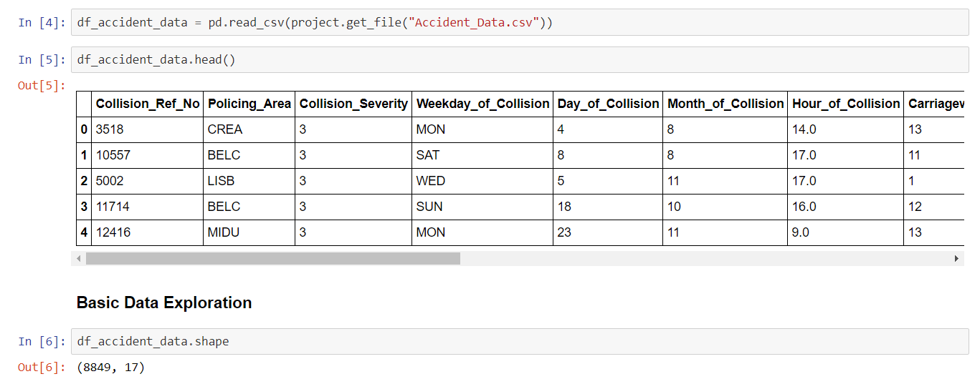
Data Acquisition and Cleaning …I
Data Acquisition
This project is based on kaggle datasets that contain an extended descriptions of different aspect of the accidents
The most relevant and useful data is considered for analysis

Slide 7
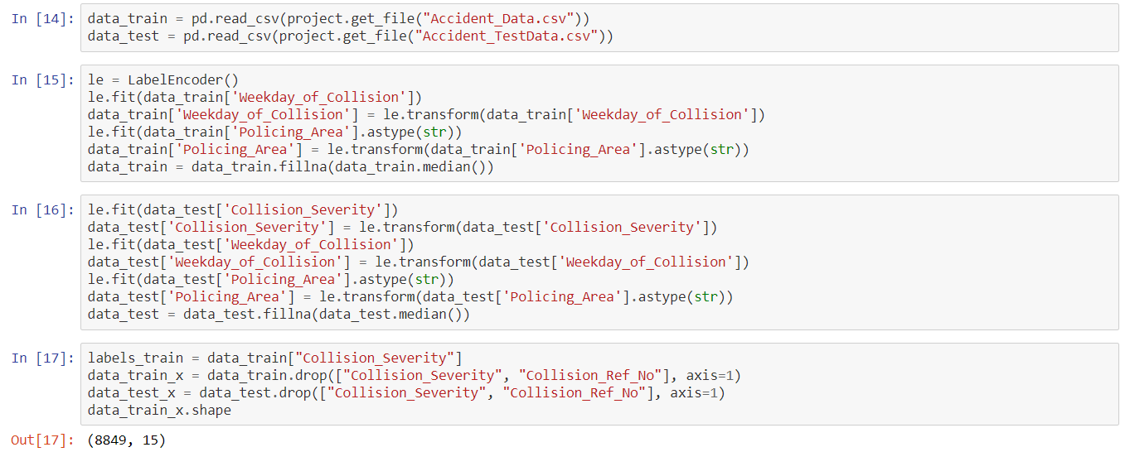
Data Acquisition and Cleaning …II
Data Cleaning
The most relevant and useful data is considered for analysis and encoding used for training and test data

Slide 8
Exploratory Data Analysis

Slide 9
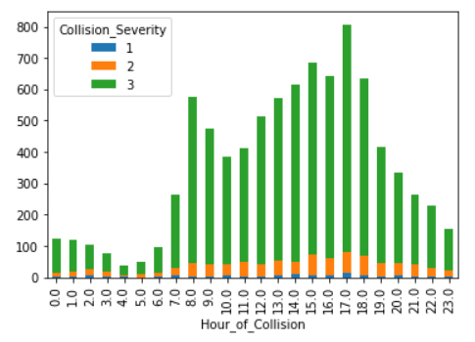
Exploratory Data Analysis …I
Collision Severity v/s. Hour of Collision
Based on the available data, plotting the collision severity against the hour of collision

Slide 10
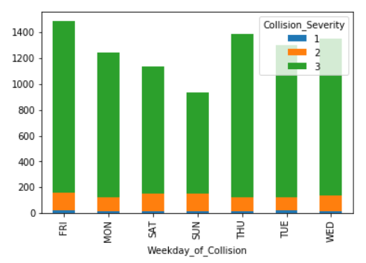
Exploratory Data Analysis …II
Collision Severity v/s. Weekday of Collision
Based on the available data, plotting the collision severity against the weekday of collision

Slide 11
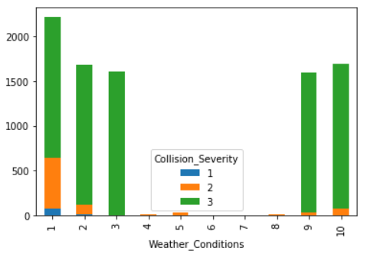
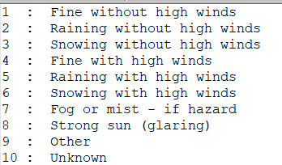
Exploratory Data Analysis …III
Collision Severity v/s. Weather Conditions
Based on the available data, plotting the collision severity against the weather conditions

Slide 12
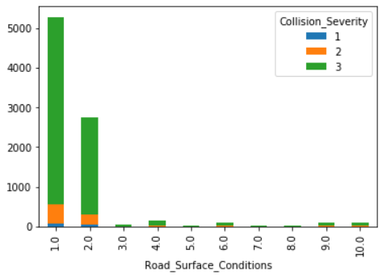
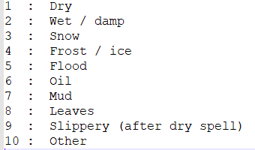
Exploratory Data Analysis …IV
Collision Severity v/s. Road Surface Conditions
Based on the available data, plotting the collision severity against the road surface conditions

Slide 13
Modeling

Slide 14
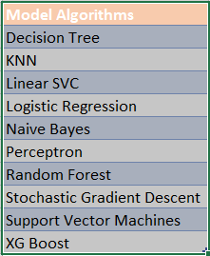
Modeling …I
Applying Standard Algorithms
Using the available dataset to train the model and then using the test dataset to evaluate the accuracy for collision severity prediction
Different Model Algorithms used are listed below:

Slide 15
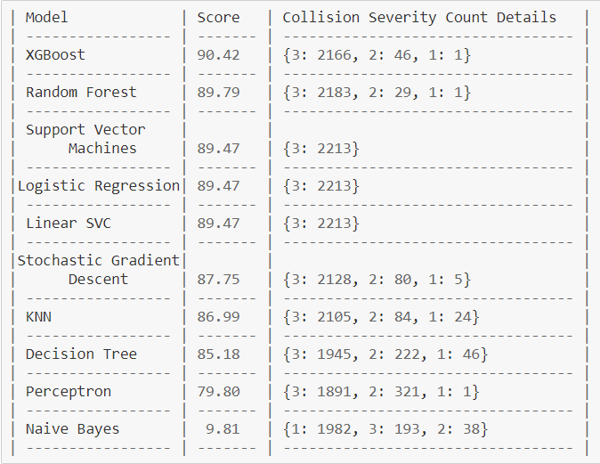
Modeling …II
Performances of different Models
Result of the evaluation of each model based on test dataset to accurately predict the collision severity
Metric sorted as per model accuracy

Slide 16
Conclusion

Slide 17
Conclusion
As seen from the results table, XG Boost along with its advantage for execution speed has also given the most accurate results for the model when evaluated against the test data for predicting collision severity

Slide 18
Future Direction

Slide 19
Future Direction
Data analysis can help build useful models to predict the severity of a traffic accident
Accuracy of the model has room for improvement and various other factors like speed, travel time, weather conditions, road conditions, peak traffic window can be corelated and analysed for improved results
These models can then be enhanced to predict potentail accident spots and time of the day along with the collision severity, which in turn can provide Authorities insight and time to develop procedures and policies for betterment of all

